Slide 1
Population aging and intergenerational transfers: a global perspective
Ronald Lee, University of California, Berkeley
Sept 26, 2011
University of Pennsylvania, Population Studies Center
My research funded by NIA R37 AG025247.
I am grateful to NTA country team members, Andy Mason, and Gretchen Donehower for practically everything. Other NTA funding: IDRC, UNFPA, EWC, CEDA, UNPD, EU

Slide 2
We are inherently social, and are sustained not only by our own efforts, but also by transfers from those of others who support us directly or indirectly.
We humans could not make it through life alone and unaided. Yes, we work and support ourselves and accumulate assets for old age.
  But before we are old enough to work, it is our parents who provide for us out of their earnings.
  And as the life cycle stage of old age expands, we rely more and more famiuly or on tax payers to support us through government programs.
Humans are inherently social, and are linked together both through private relationships and through public programs.
  Often these links take the form of intergenerational transfers – flows of income from one generation to another that do not pass through the market and are something like gifts.
In fact, at each age we make up the gap between our labor income and our consumption in one of three ways:
  assets, including homes, equities, and credit markets;
  public transfers, including pensions, education, and health care;
  and private transfers to rear our children or support our parents or receive support from them.

Slide 3
NTA is consistent with standard national accounts, but it adds the dimensions of age and of transfers, both public and private
National Transfer Accounts, or NTA for short, is a new set of methods to estimate these asset and transfer flows. NTA is consistent with standard national accounts but it goes beyond them in two important new ways.
  First, it estimates transfers within families and households, between households, and through the public sector.
  Second, it breaks down national accounts by age.
Co-directed with Andy Mason

Slide 4
Starting point for National Transfer Accounts (NTA)
Cross-sectional age profiles of labor income and consumption
Based on existing surveys, demographic data, administrative data. Adjusted to match totals in National Income and Product Accounts.
Many countries, each with own research team.
Centralized methods, quality control, training, workshops. Compare different surveys, etc.

Slide 5
Age profiles are
Population averages at each age, combining males females, including 0’s
height of age profile adjusted to be consistent with National Income and Product Account totals (given pop age distr).
For comparative purposes, standardize by dividing each economy’s age profiles by average labor income ages 30-49.

Slide 6
Estimation of consumption by age
Consumption
  Private expenditures imputed to individuals within each household
  Public in-kind transfers (e.g. education, health care)
Household expenditures on health and education
  Regressed on household composition dummies.
  Coefficients are used to allocate household totals to individuals within each household
The balance of household consumption (“Other”) is allocated in proportion to assumed equivalent adult consumer weights, same across all countries:
  .4 for ages 0-4
  Increases linearly to 1.0 at age 20
After calculation for each individual in each household, find average across all individuals in population at each age.

Slide 7
Labor Income
Labor income includes
  Wages, salaries, fringe benefits before tax
  2/3 of self employment income, unpaid family labor (1/3 to assets)
  Average includes 0’s.

Slide 8
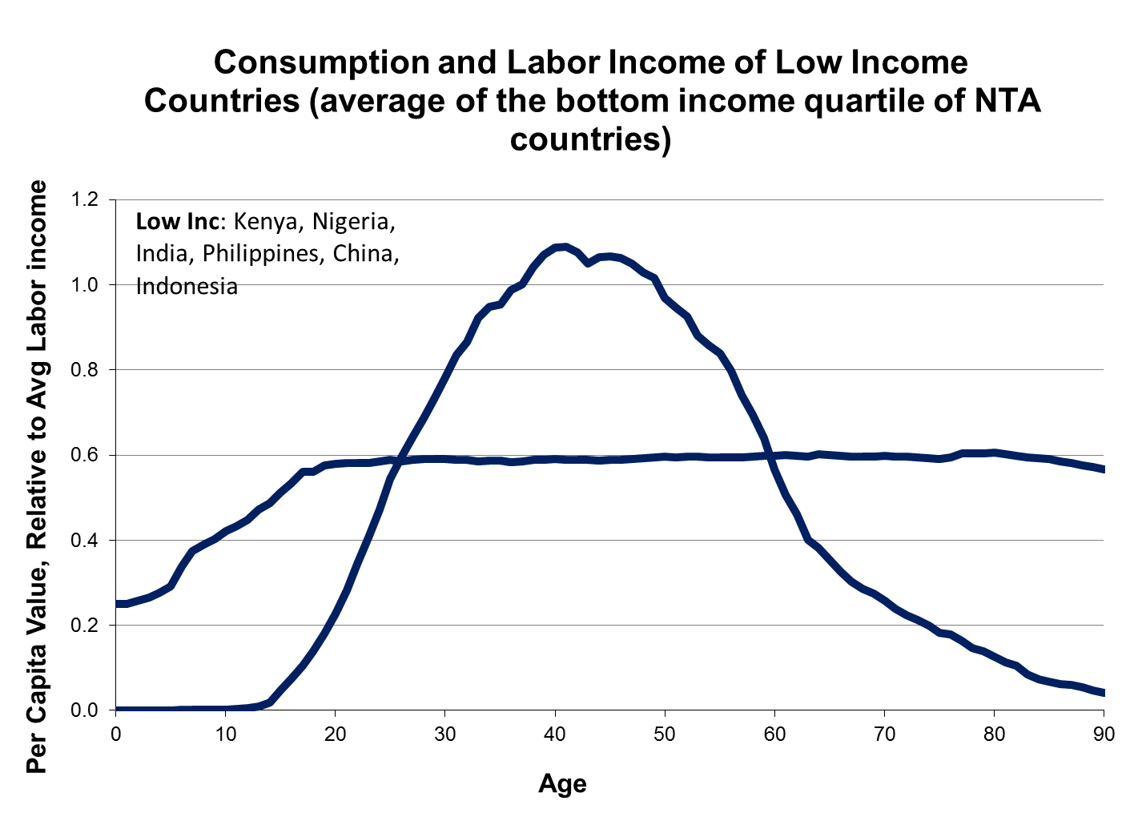

Slide 9
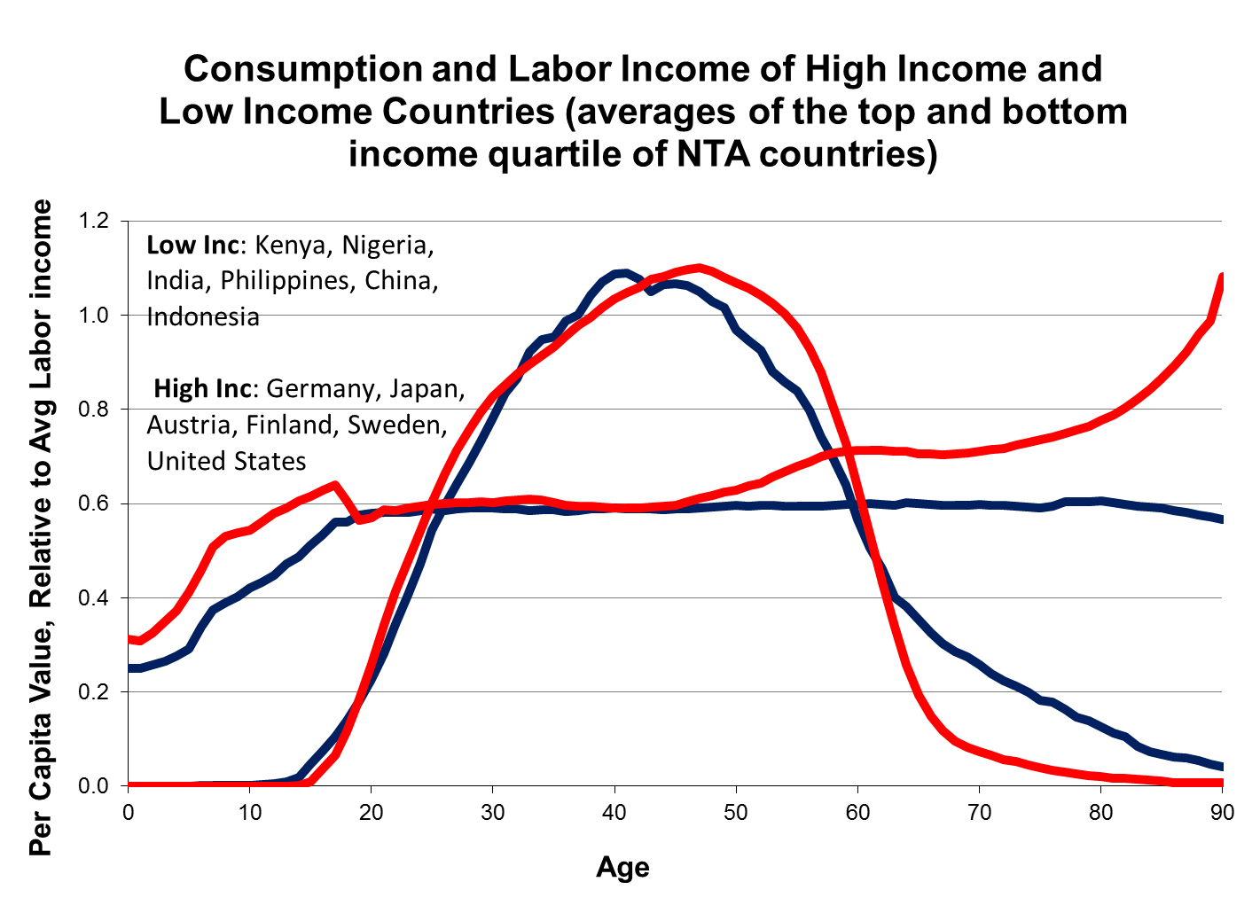

Slide 15
US consumption (private plus public in-kind transfers), 1960, 1981 and 2007
(Ratio to average labor income ages 30-49).
Source: US National Transfer Accounts, Lee and Donehower, 2011

Slide 16
Aggregate (population weighted) age specific consumption and labor income for Nigeria, 2003

Slide 17
Economic Lifecycle of Germany 2003
Aggregate flows

Slide 18
Demographic transition and changing support ratios
Fertility is high, mortality begins to decline, the growth rate and proportion of children rises.
Fertility begins to decline (maybe 50 years later), mort continues to decline. The proportion of children declines. “Dividend phase”.
Fertility stabilizes at low level, mortality continues to decline, population aging begins.

Slide 19
Support ratios show changes in labor income per consumer, based on current age profiles
Multiply age profiles by past or projected population age distributions to find hypothetical total labor income and consumption.
Support ratio = total hypothetical labor income/total hypothetical consumption for each year.
Under some assumptions, consumption per capita will be proportional to this support ratio.

Slide 20
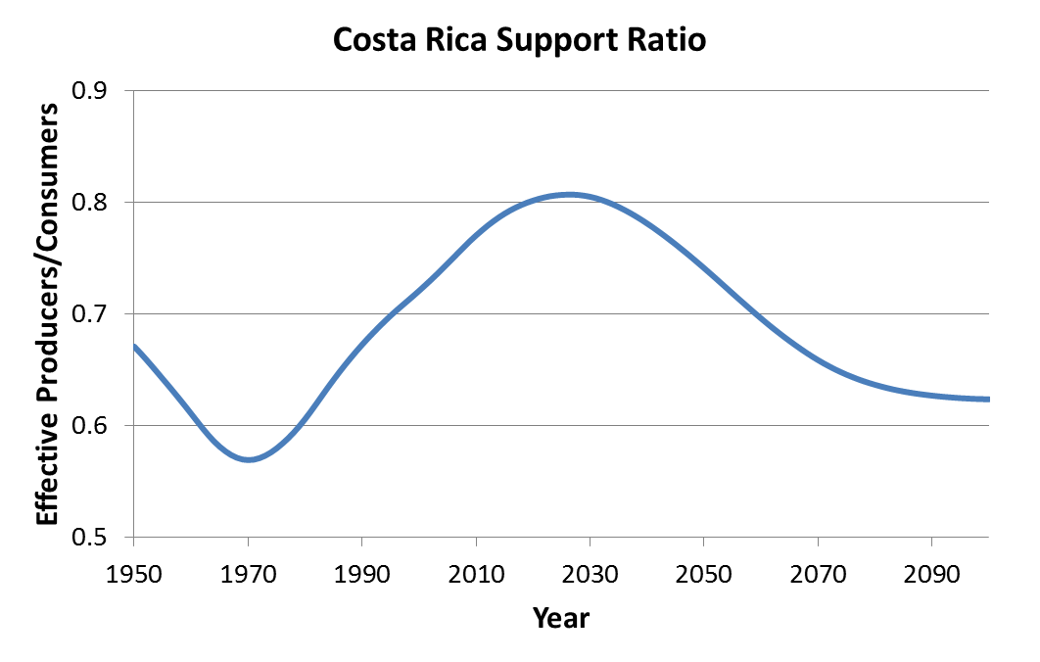

Slide 21
Increase = .7%/yr
Decrease = -.4%/yr
Contrast = 1.1%

Slide 22
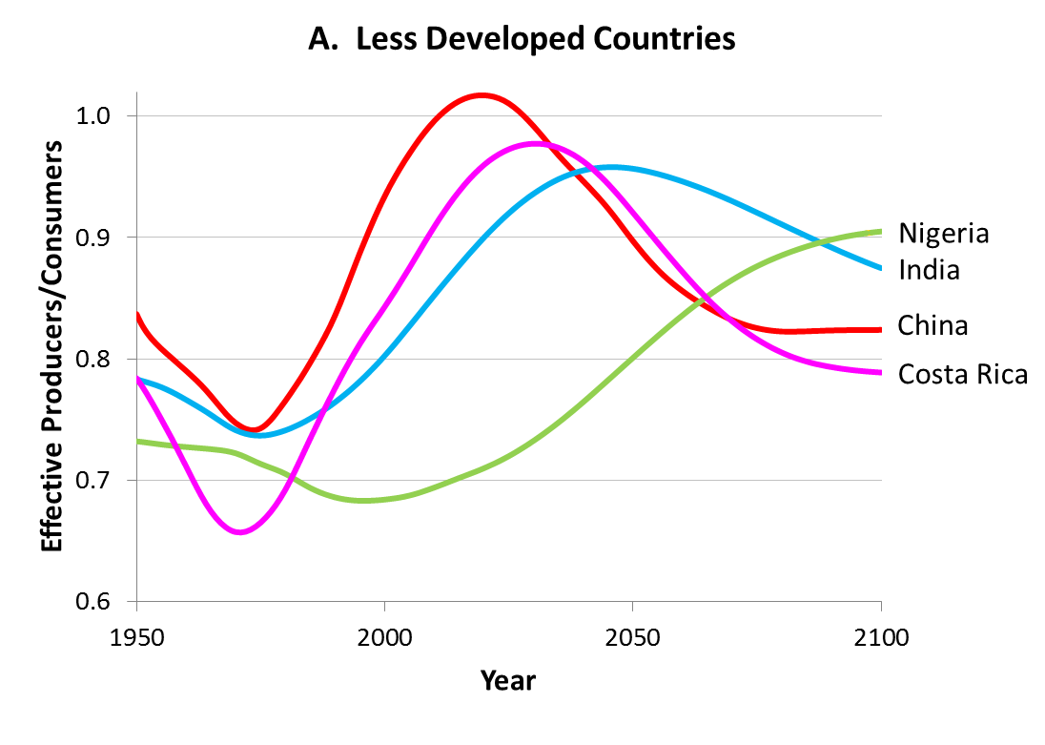
Support ratios based on the average poor country profiles and UN 2010 revision
 |  | Annual % Rate of change of support ratio
 |  | China | India | Nigeria | Costa Rica
Trough to Peak |  | 0.67 | 0.37 | 0.27 | 0.67
Peak to 2100 |  | -0.26 | -0.17 | na | -0.31

Slide 23
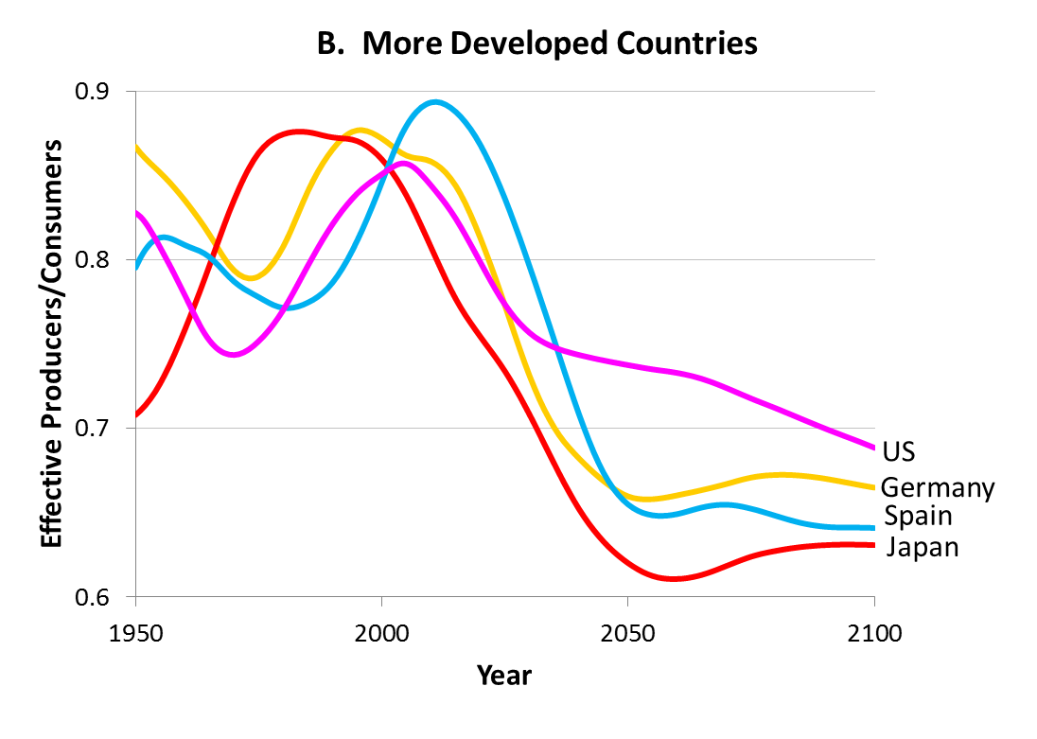
Support ratios based on the average rich country profiles and UN 2010 revision
 | Rate of change of support ratio
 | Germany | Japan | Spain | US
2010 to 2050 | -0.66 | -0.66 | -0.78 | -0.34

Slide 24
Conclusion from support ratios
Other things equal, population aging will lead to a substantial decline in consumption relative to current levels.
But will other things be equal?
The same forces that reduce the support ratio may also promote investment in capital and human capital.
Outcome depends on how old age consumption is funded, extent of reliance on assets vs transfers.

Slide 25
Investment in human capital may also offset declining support ratios
Population aging is caused mainly by low fertility.
Quantity-Quality theory in economics suggests that low fertility is associated with more investment in human capital.
NTA synthetic cohort measure of human capital investment: Sum of spending on health and education per child
  at ages 0 to 17 for health
  Ages 0-26 for education
Do for both public and private spending
Divided by average labor income to standardize

Slide 26
Fertility and pubic plus private human-capital investment per child (relative to labor income)

Slide 27
Time Series Relationship
Estimated elasticities
Japan -1.46
Taiwan -1.40
United States -0.72

Slide 28
How transfers are estimated
Net intrahousehold transfers at each age in each household are the difference between income received (labor income, asset income and public transfers) and consumption.
Net interhousehold transfers are estimated from direct survey questions.
Currently bequests at death are not included! A very important omission, to be remedied.

Slide 29
Data for US (2003), per capita
The “life cycle deficit” is consumption – labor income.
Net Private transfers is intra + inter household
Net pub transfers is benefits received – taxes paid
ABR=Asset Income – Saving=asset income consumed or transferred

Slide 30
Age Reallocations in Japan, 2004
Annual aggregate flows

Slide 31
Population aging and asset accumulation
People accumulate assets over their adult lives so the elderly hold more assets than younger adults.
In aging populations the proportion of elderly is higher, so there are more assets per capita.
If assets are invested domestically they raise capital stocks and make labor more productive. In any case, assets generate income.
However, if people expect to be supported by public or private transfers in old age, this effect is muted.

Slide 32
Shares of consumption not covered by labor income: Family Transfers, Public Transfers and Asset income (part not saved) sum to 1.0
IN
MX
US
CR
DE
BR
CN
SI
HU

Slide 33
Elders In some countries rely 100% on public sector transfers.
IN
  Sweden
  Austria
  Hungary
  Slovenia
  Brazil
MX
US
CR
DE
BR
CN
SI
HU

Slide 34
Elders In some Asian countries rely in part on family transfers.
  China
  S. Korea
  Taiwan
  Thailand
  But not Japan, Philippines or India
IN
MX
US
CR
DE
BR
CN
SI
HU

Slide 35
But in more countries, elders actually make net transfers to their children
  India Austria
  Mexico Sweden
  US Uruguay
  Spain Brazil
  Germany Indonesia
While others are near zero
  Philippines Japan
  Costa Rica Chile
  Slovenia Hungary
IN
MX
US
CR
DE
BR
CN
SI
HU

Slide 36
When consumption of the elderly is funded mainly out of public or private transfers, then population aging just raises the transfer burden on workers.
No increased assets or capital per worker.

Slide 37
In some countries, elders rely mainly on asset income.
  India
  Mexico
  Philippines
  Thailand
  US
IN
MX
US
CR
DE
BR
CN
SI
HU

Slide 38
In countries like these, population aging raises asset holdings per worker, and perhaps raises labor productivity.
Taxes and transfers are less necessary to fund population aging.

Slide 39
Conclusions
Population aging is the inevitable last stage of the demographic transition.
In rich countries, the changing shape of the economic life cycle amplifies the consequences of population aging.
However, when elder consumption is funded through continuing work or through assets, effects on younger people are reduced.
Low fertility goes with increased investment in human capital.
These changes accompanying population aging may largely offset its costs.
The challenges of population aging need not be overwhelming.

Slide 40
Following Slides Were Not Used at Penn

Slide 41
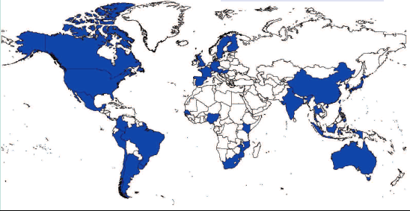
The geographic coverage of NTA
NTA Members
Asia-Pacific | Americas | Europe | Africa
Australia | Argentina | Austria | Kenya
China | Brazil | Finland | Mozambique
India | Canada | France | Nigeria
Indonesia | Chile | Germany | Senegal
Japan | Colombia | Hungary | South Africa
Philippines | Costa Rica | Italy
South Korea | Jamaica | Slovenia
Taiwan | Mexico | Spain
Thailand | Peru | Sweden
Vietnam | United States
 | Uruguay

Slide 42
Aggregate Intrahousehold Transfer Flows To and From Age Groups, relative to GDP, in Japan, Thailand and the US.
Source: Lee and Donehower (2011), Chapter on private transfers.

Slide 43
Shares of Elder Consumption Funded from Labor Income, Transfers, and Asset-based Reallocations in Eighteen NTA Countries.
IN
ID
US
MX
DE
UY
CR
SI
BR
CN
HU

